Slide 1

DEPARTMENT OF ELECTRICAL AND ELECTRONICS ENGINEERING
POWER QUALITY IMPROVEMENT IN DISTRIBUTED
GENERATION WITH POWER STORAGE SYSTEM
PROJECT ASSOCIATES
S.VISWANADH 10F01A02A1
B.SINDHU 11F05A0202
N.SRAVANA SANDHYA 10F01A0283
SK.SUBHANI 10F01A02A7
PROJECT GUIDE
MR.A.N.V.V.RAJA SEKHAR M .Tech

Slide 2

Table of contents
Abstract
Introduction
Power quality issues
Alternative methods
Limitations of alternative methods
Proposed system
Advantages of proposed system
Out put wave forms
Applications
Future scope

Slide 3
ABSTRACT
Now a days the distributed generation systems are playing a vital role in power generation.
The main problems the power quality of a distributed generation system are stationery and transient distortions in the line voltage such as harmonics, flicker, swells, sags and voltage asymmetries.
In order to improve the power quality of a distributed generation system a new approach is proposed.
The performance of this new system is simulated in two cases viz without storage battery and with the storage battery

Slide 4
Introduction
    One of the major concerns in electricity industry in today is power quality problems to sensitive loads.
    The distribution generation is a back-up electric power generating unit.
    The back generation is used primarily by consumers to provide emergency power during times when grid connected power is not available.
    The installation of back up-units close to the demand center avoids cost of transmitting power and any associated transmission losses.

Slide 5

Sustained Interruptions
Voltage Regulation
Voltage Ride Through
Harmonics
Voltage Sags
Load Following
Power Variation
Misfiring of Reciprocating Engines

Slide 6
Why distributed generation (DG) system
The five major factors that contribute to the renewed interest in distributed generation (DG) system
➢ Electricity market liberalization.
➢ Developments in DG technologies.
➢ Increased customer demand for highly reliable electricity.
➢ Environmental concerns.
➢ Constraints on the construction of new transmission lines.

Slide 7
Alternative methods
  Conventional energy generation
  Generation from Fossil and nuclear fuels
  hydro power generation

Slide 8
Limitations of alternative methods
Conventional energy sources are not renewable.
The cost of fossil and nuclear fuels will go higher.
Hydro power sources are not enough and the sites are normally far away from load centers .

Slide 9

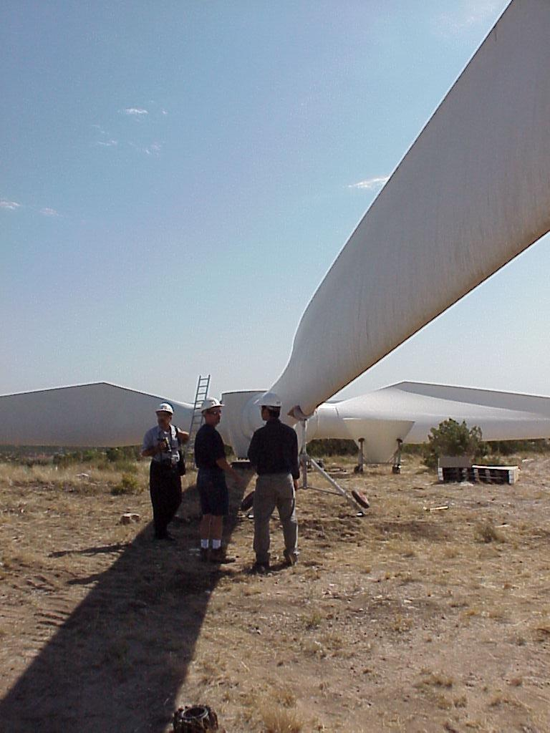
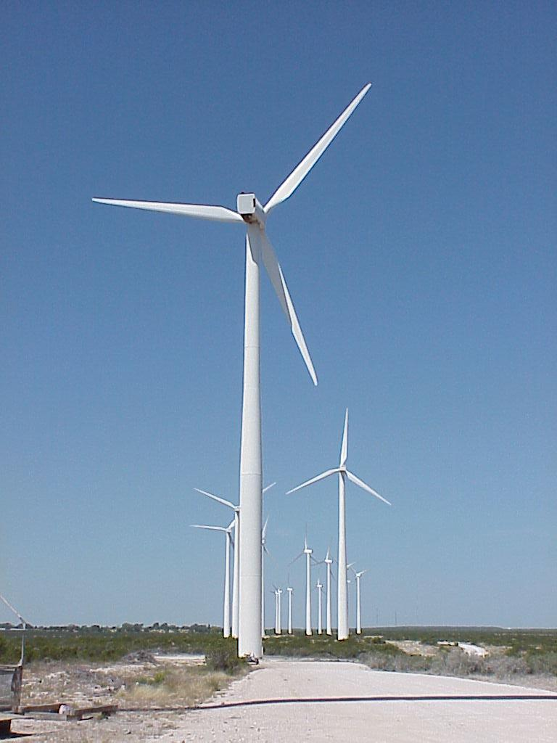
Wind Generation

Slide 10

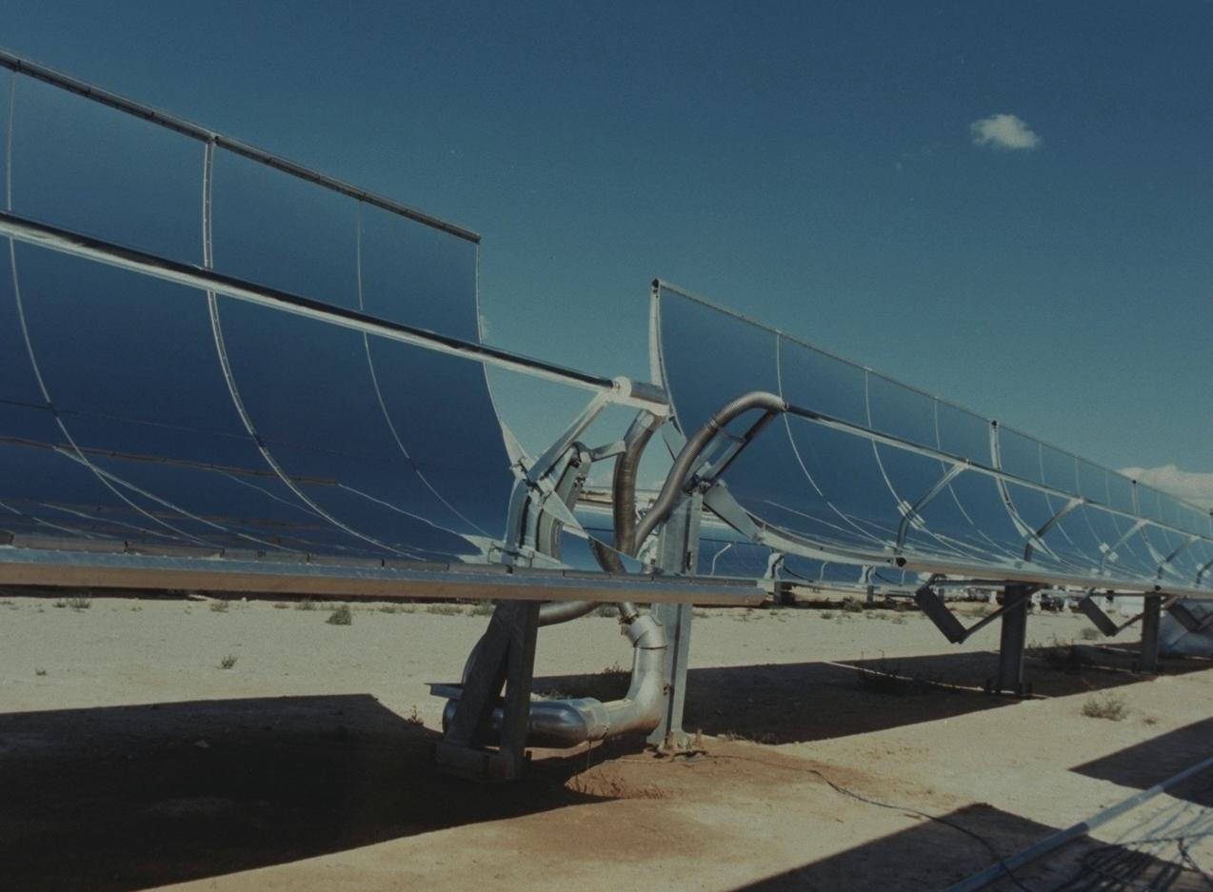
Photovoltaic

Slide 11
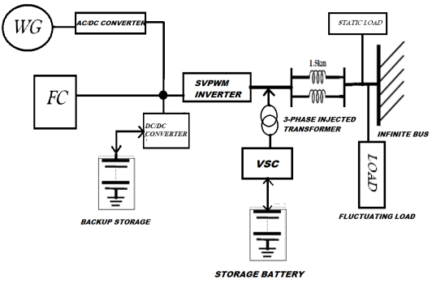
Diagram of proposed system

Slide 12

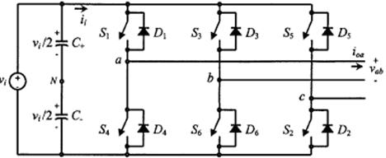

Slide 13

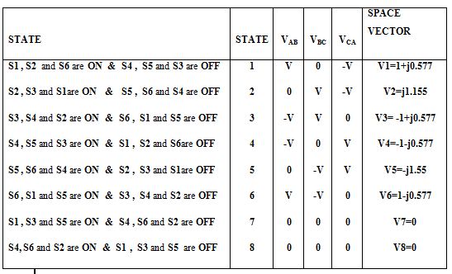

Slide 14
Advantages of proposed system
Cost for production of energy is less.
Power quality is improved.
The energy generations is renewable.

Slide 15
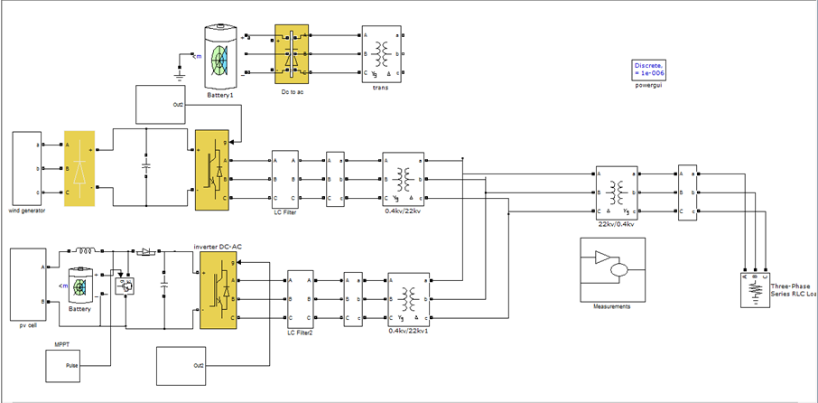
Simulations diagram without storage battery

Slide 16

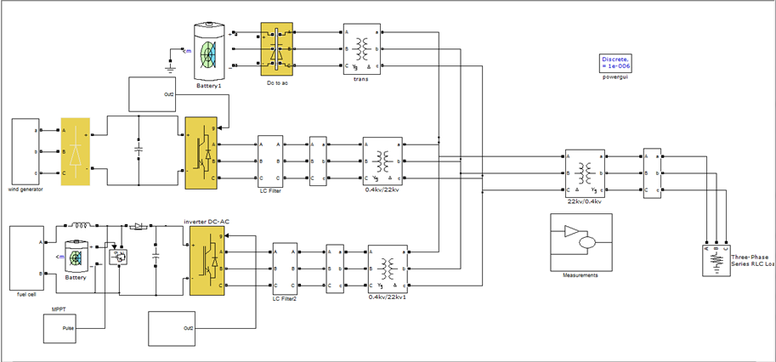

Slide 17
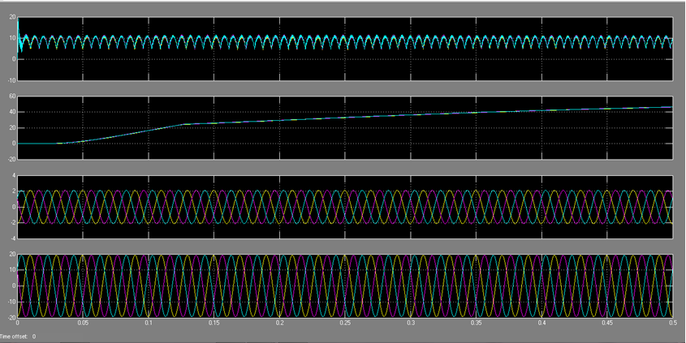
Output waveforms of voltages

Slide 18

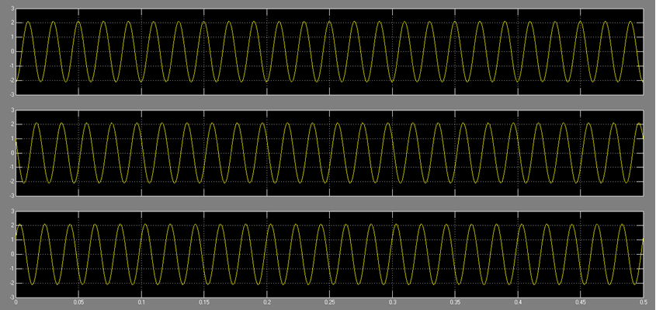

Slide 19

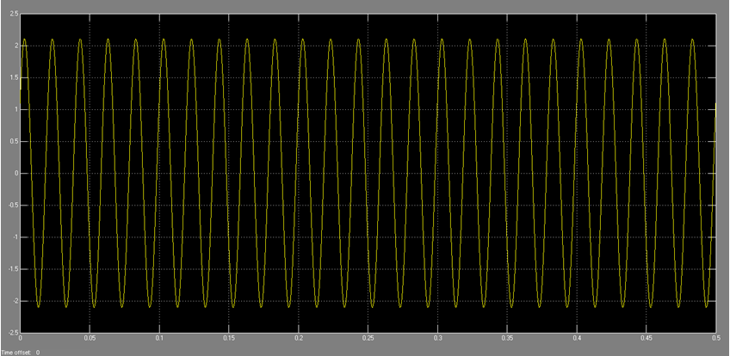


Slide 20
Applications:
Used in industrial facilities.
Used in hospitals.
Useful for commercial buildings.
Department stores.

Slide 21
CONCLUSION
Based on the analysis of test system, it is suggested that voltage sag values are major factors in estimating the DC storage value.
In the test system it is observed that after a particular amount of voltage sag, the voltage level at the load terminal decreases.
The major role play is that it can be supply constant power to varying loads, sag is reduced completely, THD of the system is very less. This scheme of implementation can be applied to various kinds of loads and systems in future.

Slide 22
Future scope
This scheme of implementation can also be applied higher rating of power generation.
The major role play is that it can be supply constant power to varying loads, sag is reduced, THD of the system is very less

Slide 23


Slide 24


